Slide 1
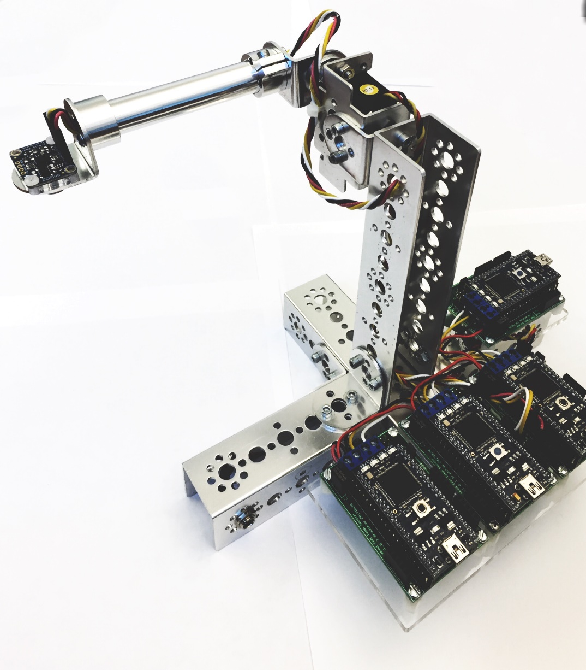
Check List (To be performed every day at the start)
Check that the testbed is plugged to the power supply.
Check that the only file downloaded in mbed #1 is: SY202_FinalProject_servo.bin
Check that the only file downloaded in mbed #2 is: SY202_FinalProject_sensor.bin
Clean any other group code (bin file) from mbed #3.
Check that mbed #4 is empty (no bin file on it – someone else might have place a bin file performing an attack).

